Slide 1

Department of Computer Science and Engineering
Adaptive Intrusion Detection in CAN-Based Vehicular Networks Using Transfer Learning for Evolving Threats
PRESENTED BY
Sk. Y. Ijaz Ahamad (21471A0557)
S. V. S. Girish (21471A0558)
T. Nagendra Babu (21471A0537)
Under the Guidance of,
Dr. D. Venkata Reddy _{M. Tech., Ph.D.},
Assistant Professor,
Department of Computer Science and Engineering,
Narasaraopeta Engineering College (Autonomous),
Narasaraopet - 522 601.

Slide 2
OUTLINE
Abstract
Introduction
Literature Survey
Research Gaps
Problem Statement
Objectives
Block Diagram / Flow Diagram
Methodology
Implementation
Results and Analysis
Conclusion & Future Scope
References
Question and Answers
Acknowledgements

Slide 3
ABSTRACT
Increasing connectivity in vehicular networks exposes Controller Area Networks (CAN) to significant cybersecurity threats.
Hybrid Intrusion Detection System (IDS) leveraging Transfer Learning (TL) is proposed for evolving threats.
Combines CNN, LSTM, and Random Forest models for high detection accuracy.
Achieved over 99% accuracy across multiple attack classes (DoS, RPM spoofing, gear spoofing, Fuzzy attacks).
Dynamic reconfigurability ensures adaptability to new threats with minimal retraining.

Slide 4
INTRODUCTION
Context:
Modern vehicular systems increasingly rely on CAN for in-vehicle communication.
Rising cyber threats challenge the effectiveness of traditional IDS
Need for Research:
Static IDS approaches struggle with adaptability to emerging attack patterns.
Incorporating TL can significantly enhance IDS adaptability and accuracy.
Proposed Solution:
A reconfigurable IDS using hybrid deep learning and ML techniques for real-time threat detection.

Slide 5
LITERATURE SURVEY
No | Title | Author | Journal Name & Year | Methodology Adapted | Key Findings | Gaps
1 | Transfer Learning-Based Intrusion Detection System for a Controller Area Network | N. Khatri, S. Lee, and S. Y. Nam | IEEE Access, 2023 | Employed transfer learning with pre-trained models to adapt to evolving vehicular network threats. | High detection accuracy (>99%) and low computation costs, ensuring efficiency and adaptability. | Limited real-world deployment testing and lack of validation for novel attack scenarios.
2 | A Deep Learning-Based IDS for Automotive Theft Detection for In-Vehicle CAN Bus | J. A. Khan, D. W. Lim, and Y. S. Kim | IEEE Access, 2023 | Applied deep learning techniques for theft detection on in-vehicle CAN bus data. | Effective in detecting theft scenarios using advanced ML methods, achieving good precision. | Does not explore hybrid techniques or temporal dependencies for broader attack coverage.
3 | A Novel Detection Approach of Unknown Cyber-Attacks for Intra-Vehicle Networks Using Recurrence Plots and Neural Networks | O. Y. Al-Jarrah, K. El Haloui, M. Dianati, and C. Maple. | IEEE Open Journal of Vehicular Technology, 2023 | Leveraged recurrence plots with neural networks to identify unknown attack patterns. | Improved detection capability for unknown and emerging threats, enhancing cybersecurity measures. | Real-time implementation and adaptability for dynamically evolving threats remain challenging.

Slide 6
No | Title | Author | Journal Name & Year | Methodology Adapted | Key Findings | Gaps
4 | A Novel Hybrid Quantum-Classical Framework for an In-Vehicle Controller Area Network Intrusion Detection | M. S. Salek, P. K. Biswas, J. Pollard, et al. | IEEE Access, 2023 | Combined quantum computing with classical ML in a hybrid IDS framework for vehicular CAN systems. | Achieved significant accuracy improvements and showcased the potential of hybrid quantum-classical models. | High computational demands and lack of feasibility studies for real-time vehicular applications.
5 | An Intelligent Intrusion Detection System for Smart Consumer Electronics Network | D. Javeed, M. S. Saeed, I. Ahmad, et al. | IEEE Transactions on Consumer Electronics, 2023 | Developed an ensemble learning-based IDS tailored for smart consumer electronics. | High detection rates and robust performance against false positives in consumer electronics. | Limited applicability to CAN-based vehicular networks and underexplored integration with automotive IDS.
6 | Intrusion Detection System for In-Vehicle CAN-FD Bus ID Based on GAN Model | XU Wang, Yihu Xu, Yinan Xu, Ziyi Wang, Yujing Wu | IEEE Access, 2024 | Improved GAN model with a dual discriminator and image-based feature extraction | Achieved 99.93% detection rate with 0.15 ms response time | Needs adaptation for extended CAN-FD IDs and additional fault-tolerant measures​.

Slide 7
.
No | Title | Author | Journal Name & Year | Methodology Adapted | Key Findings | Gaps
7 | Multiple Observation HMM-Based CAN Bus Intrusion Detection System for In-Vehicle Network | Chen Dong, Hao Wu, Qingyuan Li | IEEE Access, 2023 | Hidden Markov Model (HMM) with multiple observation sequences for anomaly detection. | High detection rates (>99%) for DDoS, fuzzy, and replay_variant attacks | Lower performance for masquerade and reply_invariant attacks; requires optimal time window tuning.
8 | Transformer-Based Attention Network for In-Vehicle Intrusion Detection | Trieu Phong Nguyen, Heungwoo Nam, Daehee Kim | IEEE Access, 2023 | Transformer-based self-attention model for CAN bus intrusion detection. | Outperforms RNN-based models, achieves high detection rates, especially for replay attacks. | Challenges with single-message detection, needs improvements for detecting message injections​.
9 | G-IDCS: Graph-Based Intrusion Detection and Classification System for CAN Protocol | S.B. Park et al. | IEEE Access, 2023 | Graph-based IDS with threshold-based classifier and ML-based attack classification | Improved accuracy over previous methods, robust against attack variations | Requires optimization for low-rate attack detection, lacks real-time adaptation​.
10 | CF-AIDS: Comprehensive Frequency-Agnostic Intrusion Detection System on In-Vehicle Network | M. R. Islam et al. | IEEE Access, 2024 | Gabor filter-based high-resolution feature extraction combined with GRU deep learning model | Achieves >99% detection for high-frequency attacks, effective in binary classification. | Accuracy drops for low-frequency injection attacks, multi-class classification challenges remain​

Slide 8
LITERATURE SURVEY
Traditional Models:
Static IDS models rely on predefined rules.
Effective for known threats but lack adaptability to evolving patterns.
Deep Learning:
CNNs: Extract spatial features from CAN traffic (e.g., byte sequences).
RNNs: Analyze temporal dependencies in sequential data.
Hybrid Approaches:
CNN-LSTM for combined spatial-temporal analysis.
Quantum-Classical enhances accuracy but costly in computation.

Slide 9
RESEARCH GAPS
Lack of dynamic adaptability in traditional IDS approaches.
Limited exploration of hybrid deep learning models in real-time vehicular networks.
High computational overhead in quantum-classical frameworks for practical deployment.
Insufficient testing of TL-based IDS in real-world vehicular environments.
Narrow focus on specific threats, limiting broader applicability.

Slide 10
PROBLEM STATEMENT
Core Issue:
Existing IDS systems for CAN-based vehicular networks are insufficiently adaptive to evolving cyber threats.
Challenges:
Balancing high detection accuracy with computational efficiency.
Real-time reconfigurability to detect both known and emerging attack patterns.

Slide 11
OBJECTIVES
Design and Develop:
A hybrid IDS using CNN, LSTM, and TL for enhanced detection accuracy.
Adaptability:
Ensure dynamic reconfiguration for evolving attack patterns with minimal retraining.
Efficiency:
Achieve high accuracy (>99%) with low false positive rates in real-time scenarios.
Validation:
Evaluate the system using comprehensive datasets (e.g., car hacking dataset) under varied attack scenarios.

Slide 12
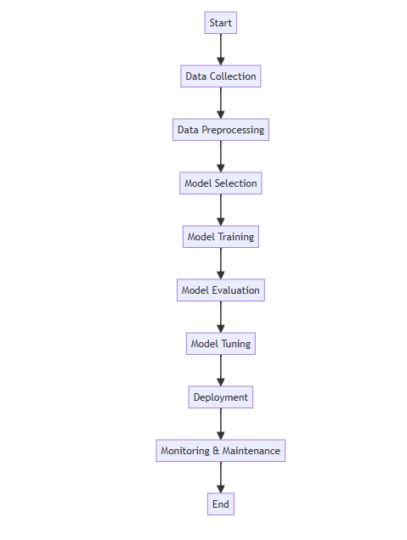
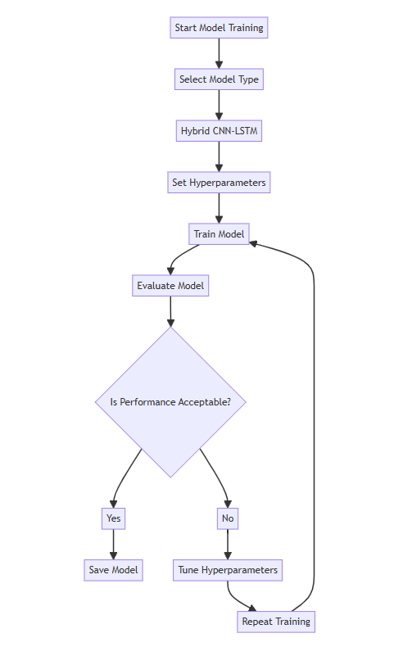
BLOCK DIAGRAM OR FLOW DIAGRAM

Slide 13
METHODOLOGY
Data Collection
Loaded car-hacking dataset with .csv files(Fuzzy_attack, RPM_attack, ..).
Loaded dataset with attributes: Timestamp, CAN ID, DLC, DATA[0-7] and Flag.
Removed duplicate and null values to ensure clean and reliable data.
Preprocessing
Data Transformation:
Label Encoding: Converted categorical data (e.g., DATA[0-7], Flag) into numerical format using LabelEncoder.
Hexadecimal to Decimal Conversion: Transformed CAN ID and DATA[0-7] from HEX to decimal for numerical analysis.
Feature Scaling and Normalization:
Used StandardScaler to scale features for uniformity.

Slide 14
Feature Engineering:
CAN_ID_diff : Difference between consecutive CAN ID values.
Payload_sum : Sum of DATA[0-7] values.
Feature Selection:
Created a correlation matrix to identify relevant features.
Selected features with a correlation threshold > 0.1 with the target variable (Flag).
Data Preparation for Modeling:
Tokenized CAN ID messages and converted them to sequences for model compatibility.
Split data into training (70%), validation (15%), and test (15%) sets.

Slide 15
METHODOLOGY
Model Design
Hybrid Transfer Learning (TL)
- Combines pre-trained models with fine-tuning for evolving attacks.
- Enhances adaptability and reduces training time.
Hybrid CNN-LSTM
- CNN: Extracts spatial features from CAN data.
- LSTM: Captures temporal dependencies for time-series anomaly detection.
- Optimized for real-time detection with low latency.
RNN Model
- Baseline for comparison; detects static patterns.
- Effective for simple attacks like DoS.

Slide 16
IMPLEMENTATION
SYSTEM REQUIREMENTS
Hardware Requirements
Processor : intel Core i5
Cache memory : 4MB(Megabyte)
RAM : 12.7GB (gigabyte)
Hard Disk : 166.8GB
Compute Engine : T4 GPU
Software Requirements
Operating System : Windows 10, 64-bit OS
Coding Language : Python
Python distribution : Google Colab Pro , Flask
Browser : Any Latest Browser like Chrome

Slide 17
CHALLENGES FACED & SOLUTIONS
🚧Challenges:
Large Dataset Processing: Difficulty in handling and processing large volumes of CAN-based vehicular data.
Overfitting of Models: The models showed high accuracy on the training set but poor performance on unseen data.
💡 Solutions:
Optimized Frameworks: Leveraged Google Co-lab Pro with T4 GPU for faster processing and efficient computation.
Regularization Techniques: Applied dropout layers and early stopping to reduce overfitting.

Slide 18
RESULTS & ANALYSIS
The Hybrid TL, CNN-LSTM, and RNN models achieved 99.82% accuracy with precision, recall, and F1-scores around 0.9982. The Random Forest model showed lower accuracy at 95.65% with higher false positives, emphasizing the superior performance of hybrid models for CAN intrusion detection.
Table: Performance metrics for Fuzzy attack
Model | Accuracy (%) | Precision | Recall | F1-Score
Hybrid Transfer Learning | 99.82 | 0.9982 | 0.9982 | 0.9982
CNN-LSTM | 99.82 | 0.9980 | 0.9985 | 0.9982
RNN | 99.82 | 0.9975 | 0.9980 | 0.9977
Random Forest | 95.65 | 0.9543 | 0.9670 | 0.9606

Slide 19
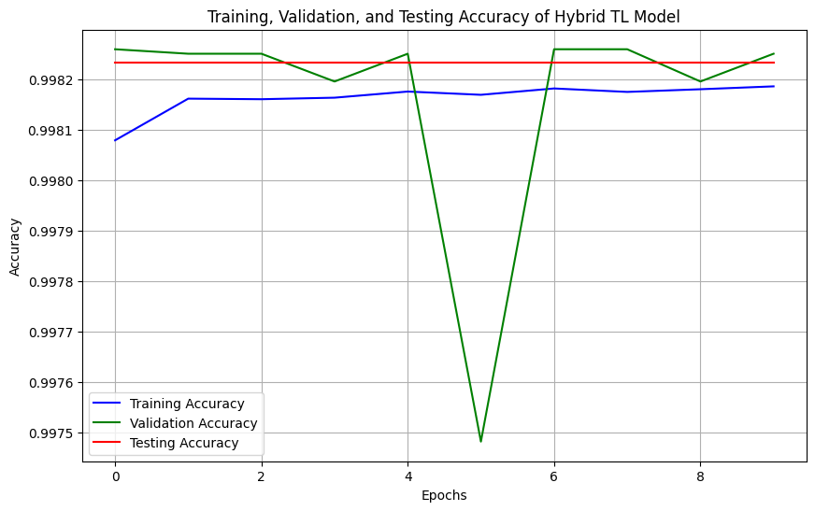
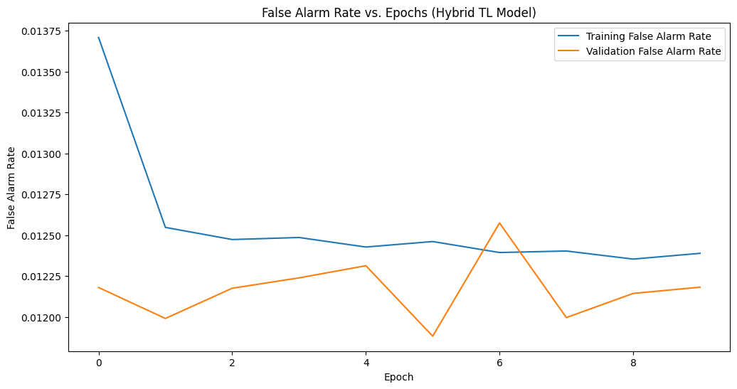
RESULTS & ANALYSIS
Figure1: Comparing Train, Test, and Validation Accuracy for Hybrid TL Model.
Figure2: False alarm rate vs. epoch for Hybrid TL Model.

Slide 20
CONCLUSION and FUTURE SCOPE
Conclusion
The Hybrid Transfer Learning (TL) and CNN-LSTM models demonstrated superior performance, achieving 99.82% accuracy with high precision, recall, and F1-scores, making them ideal for CAN-based Intrusion Detection Systems (IDS). Their adaptability and ability to capture complex patterns ensure robust attack detection in dynamic environments, while the RNN and Random Forest models serve as valuable alternatives with some trade-offs in performance.
Feature Scope
Future efforts could focus on enhancing model scalability for large datasets, integrating federated learning to improve privacy, and developing lightweight versions of the models for real-time deployment in resource-constrained automotive systems. Additionally, incorporating zero-day attack detection techniques can further strengthen IDS against emerging threats.

Slide 21
REFERENCES
[1] N. Khatri, S. Lee, and S. Y. Nam, "Transfer Learning-Based Intrusion Detection System for a Controller Area Network," IEEE Access, vol. 11, pp. 120963-120981, Sept. 2023.
[2] J. A. Khan, D. W. Lim, and Y. S. Kim, "A Deep Learning-Based IDS for Automotive Theft Detection for In-Vehicle CAN Bus," IEEE Access, vol. 11, pp. 112814-112827, Sept. 2023.
[3] O. Y. Al-Jarrah, K. El Haloui, M. Dianati, and C. Maple, "A Novel Detection Approach of Unknown Cyber-Attacks for Intra-Vehicle Networks Using Recurrence Plots and Neural Networks," IEEE Open Journal of Vehicular Technology, vol. 4, pp. 271-280, Mar. 2023.
[4] M. S. Salek, P. K. Biswas, J. Pollard, J. Hales, Z. Shen, V. Dixit, M. C. Chowdhury, S. M. Khan, and Y. Wang, "A Novel Hybrid Quantum Classical Framework for an In-Vehicle Controller Area Network Intrusion Detection," IEEE Access, vol. 11, pp. 96081-96082, Aug. 2023.
[5] D. Javeed, M. S. Saeed, I. Ahmad, P. Kumar, A. Jolfaei, and M. Tahir, "An Intelligent Intrusion Detection System for Smart Consumer Electronics Network," IEEE Transactions on Consumer Electronics, vol. 69, no. 4, pp. 906-912, Oct. 2023.

Slide 22
REFERENCES
[6] M. R. Islam, M. Sahalabadi, K. Kim, Y. Kim, and K. Yim, "CF-AIDS: Comprehensive Frequency-Agnostic Intrusion Detection System on In-Vehicle Network," IEEE Access, vol. 12, pp. 13971-13981, Jan. 2024.
[7] W. Xu, Y. Xu, Z. Wang, Y. Wu, and Y. Wang, "Intrusion Detection System for In-Vehicle CAN-FD Bus ID Based on GAN Model," IEEE Access, vol. 12, pp. 82402-82412, Sept. 2024.
[8] S. B. Park, H. J. Jo, and D. H. Lee, "G-IDCS: Graph-Based Intrusion Detection and Classification System for CAN Protocol," IEEE Access, vol. 11, pp. 39213-39225, Apr. 2023.
[9] T. P. Nguyen, H. Nam, and D. Kim, "Transformer-Based Attention Network for In-Vehicle Intrusion Detection," IEEE Access, vol. 11, pp. 55389-55403, June 2023.
[10] C. Dong, H. Wu, and Q. Li, "Multiple Observation HMM-Based CAN Bus Intrusion Detection System for In-Vehicle Network," IEEE Access, vol. 11, pp. 35639-35648, Mar. 2023.

Slide 23
ACKNOWLEDGEMENT
We would like to express our sincere gratitude to the faculty and staff of Narasaraopeta Engineering College for their guidance and encouragement throughout the development of this project. Their insights and expertise have been invaluable.
We also extend our thanks to the administration for providing the necessary resources and a platform to showcase our work. This opportunity has been instrumental in enhancing our learning and growth.
For any questions or further discussions, feel free to reach out:-
Email: sk.ijazahamad390@gmail.com Phone: 7794951864
Email: sindesapthagirish@gmail.com Phone:8247391167
Email: babubabu43154@gmail.com Phone: 7286044867

Slide 24


Slide 25


